Slide 1
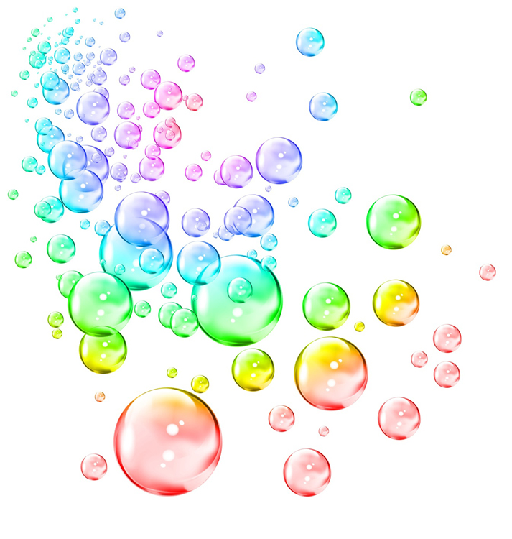
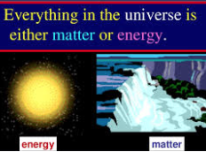
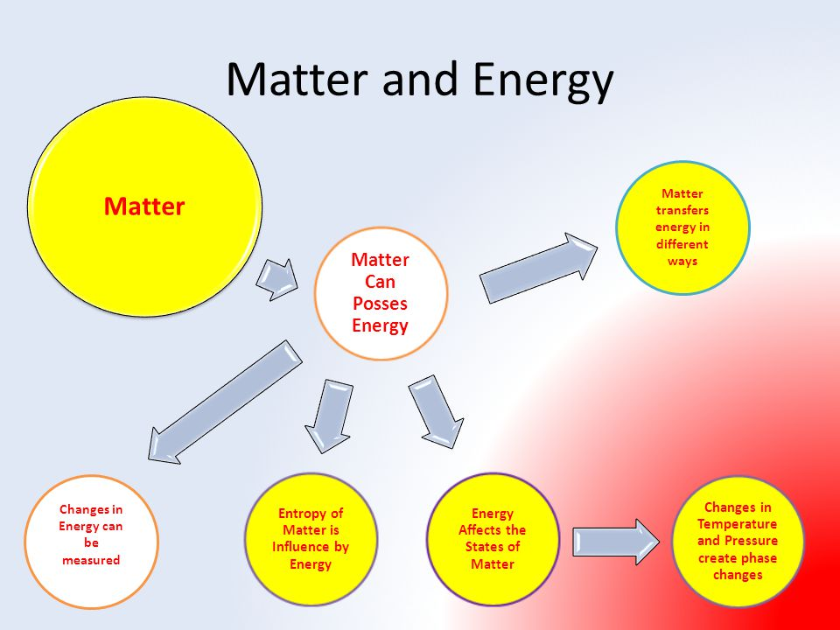

Matter and energy interact in the physical world.

Slide 2
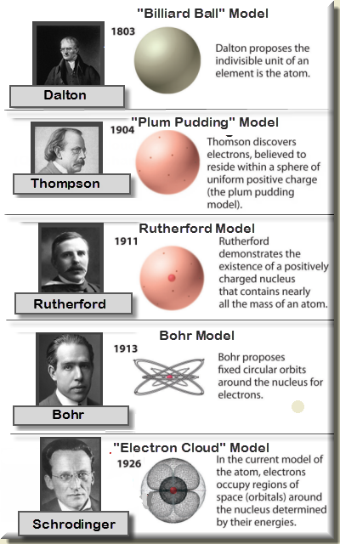
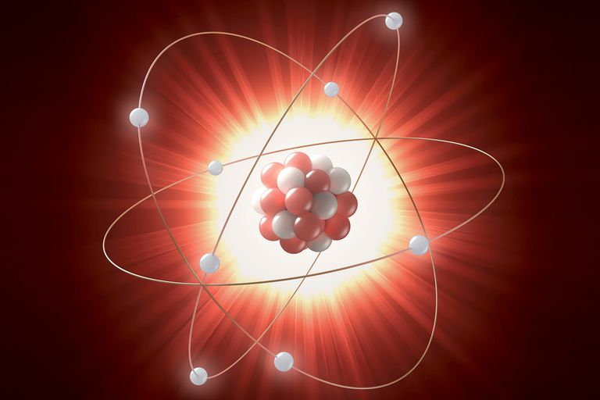
Atoms – building blocks of matter
Atoms make up all matter
Name the last name of each
scientist and what they
contributed to the atom model.
The history of our understanding of the atom is a classic example of how scientific knowledge changes over time. As one thinker builds on another thinker’s ideas and as technology advances, our understanding of how the world works becomes more and more accurate.

Slide 3
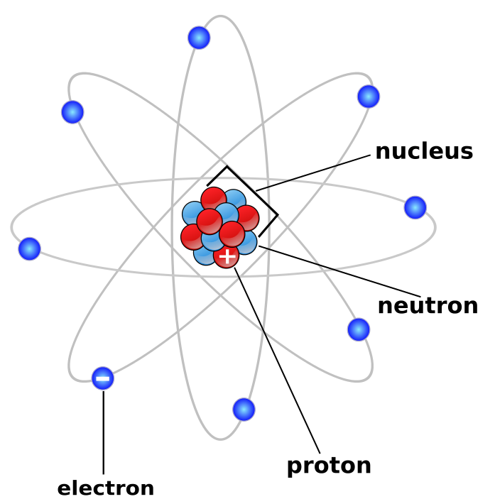
atoms –building blocks of matter
Atoms are made of smaller particles.
There are three main types of particles.
What are they?
What are their charges?
Which part of the atoms makes up most of the mass?
Which part makes up most of the atom’s size?
The force of ___________ keeps the electrons moving around the nucleus.
What is accurate about this model?
What is inaccurate about this model?

Slide 4
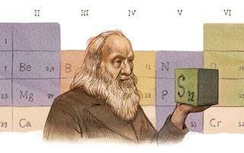
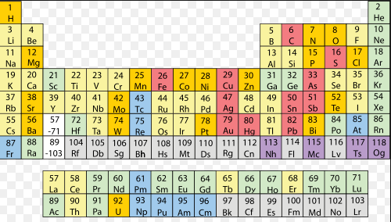
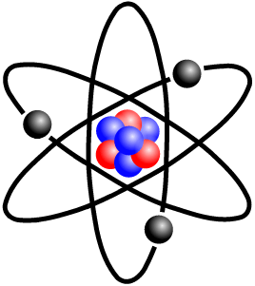
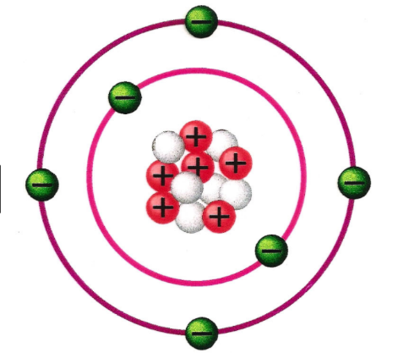
Elements on the periodic table
Early scientists recognized that different types of matter had different properties. Dmitri Mendeleev organized the elements on a table by the property of _________.
Our current periodic table organizes the elements by their differences in atoms.
Although all atoms have a similar structure, the differ in the number of subatomic particles.
Our current period table is organized by the number of _______________in the atom.
What two elements do these
two models represent?
How do you know?

Slide 5
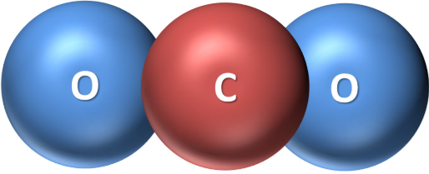
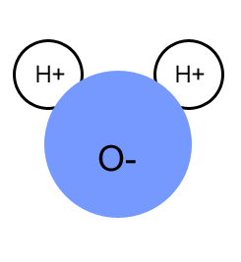

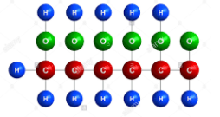
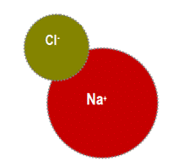
Molecules are made of atoms
When two or more atoms bond, they form a molecule. They make up most substances in our world.
Name the following common molecules in our world:

Slide 6
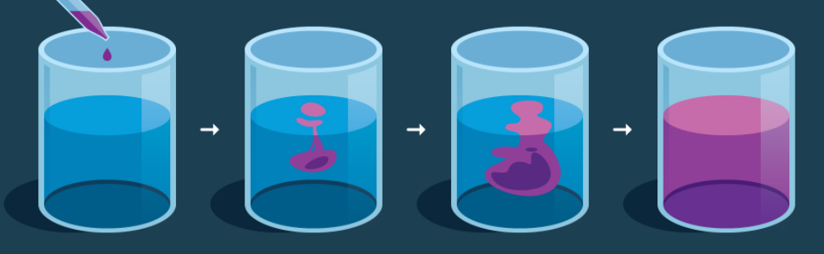
Molecular motion
Describe this phenomena using your knowledge of matter and energy. You need to use the following words in your explanation:
-matter
-energy
-atoms
-molecules

Slide 7
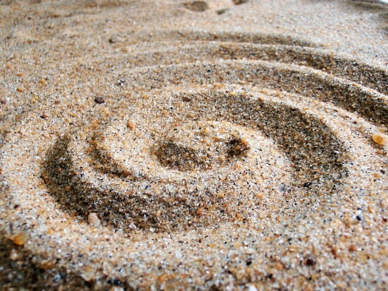
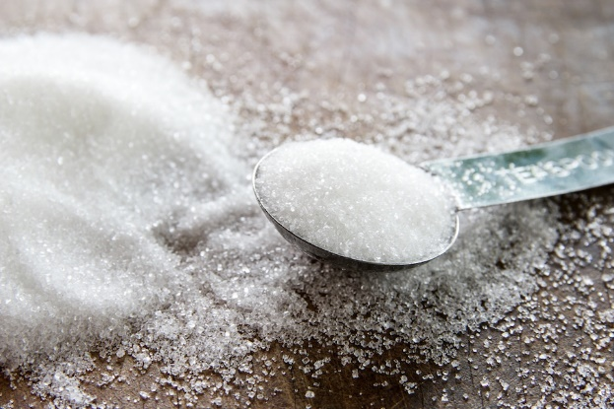
Properties of matter
These are two different substances sand & sugar
Describe these two substances.
What is the same about these two items?
What is different about these two items?
What are their uses?
Name specific properties of each.

Slide 8
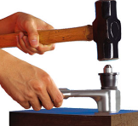
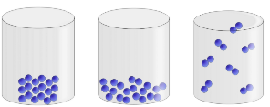
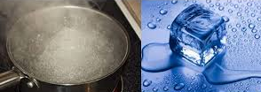
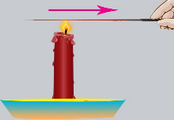
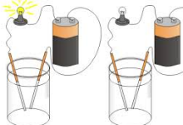
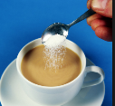
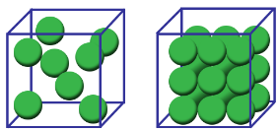
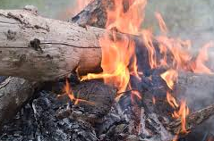
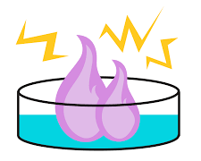

Properties of matter
Define the following properties:
Hardness
State of matter
Melting & boiling point
Conductivity
Ability to dissolve
Density
Flammability
Reactivity
Malleability

Slide 9

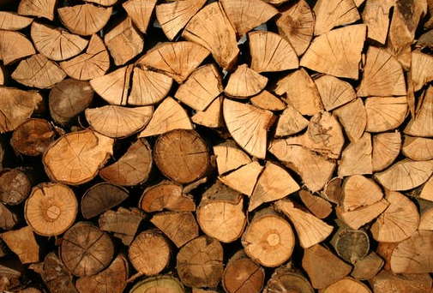
Properties and functions
A substance’s properties determine the way it is used.
These are two common substances that are used in our world.
List properties of each substance.
Then tell ways they are used due to those properties.

Slide 10
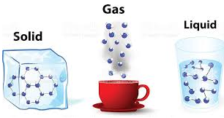
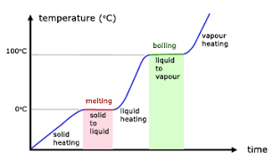
State of matter and heat energy
Describe what is happening in these models by using the following terms:
*cause and effect
*particle motion
*temperature
*density
*state of matter
*heat energy
Use computational thinking
in this description.

Slide 11
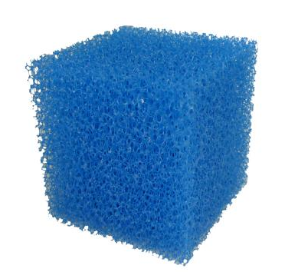
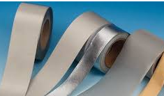
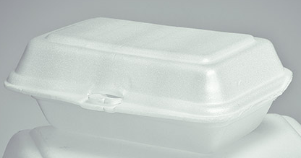
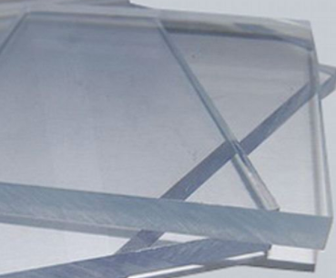
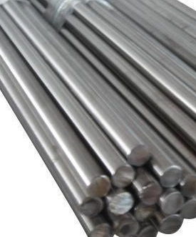
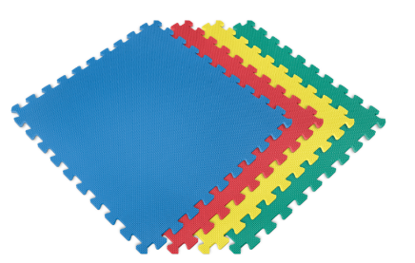

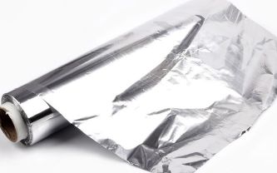
Phase change rate
You are a manager of a sports team. The coach has asked you to make use of a wooden compartment under the bench to store ice for injured players. Which of the following materials might be beneficial for this purpose? Why?

Slide 12
Evidence of chemical reactions
Change in color
Change in odor
Energy given off
(light, heat, sound)
Gas produced
Precipitate forms

Slide 13
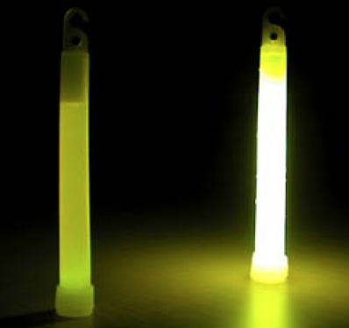
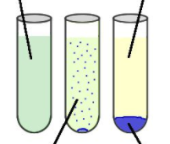
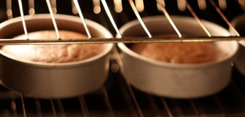
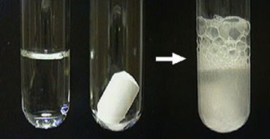

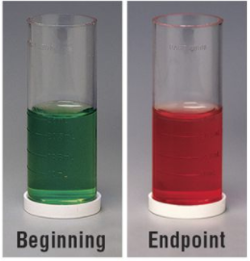
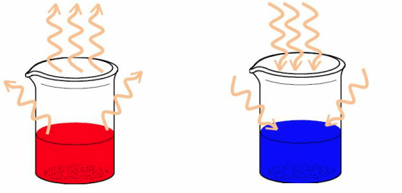
How do you know these are chemical reactions?

Slide 14
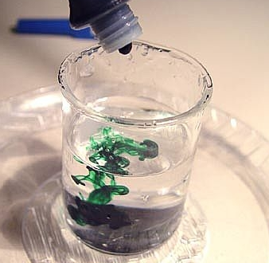
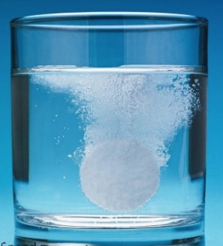
Chemical reaction or not??
Which of these is a chemical reaction and which is not?
How do you know?

Slide 15
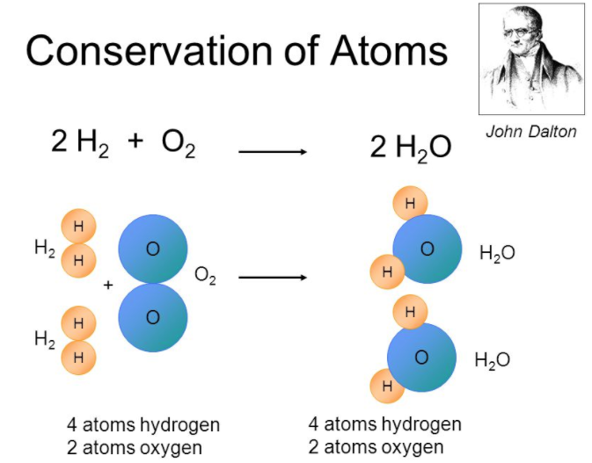
Conservation of atoms
John Dalton’s contributions to the atomic theory were based on this conservation concept.
He stated that a chemical reaction is a rearrangement of atoms.

Slide 16
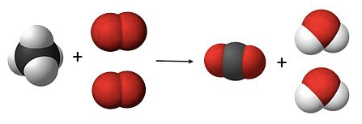
Conservation of mass
The following are part of this reaction:
  H₂O (water), CO₂ (Carbon Dioxide), CH₄ (Methane) and O₂ (Oxygen Molecules)
  Reactant atoms: Product atoms:
  Hydrogen ___ Hydrogen ___
  Oxygen ___ Oxygen ___
  Carbon ___ Carbon ___
  What does this prove?

Slide 17
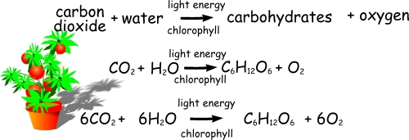
Conservation of mass
Matter – can’t be created or destroyed
Mass – can’t be created or destroyed

Slide 18
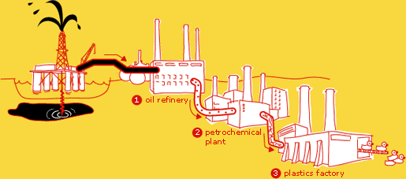

Synthetic materials
Synthetic products come from natural resources.
Chemical reactions are used to change natural resources into synthetic products with new properties to be used in society.
What properties make plastic a useful product?

Slide 19
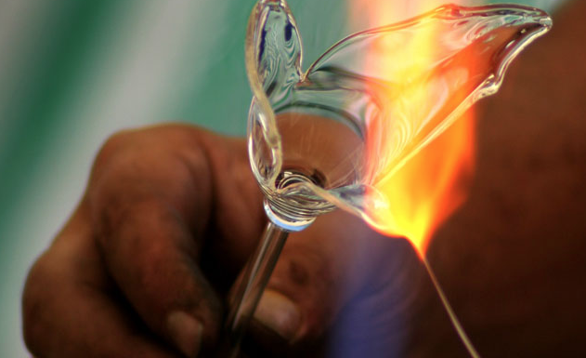
Changes in matter
Matter has physical and chemical properties.
Matter can change physically & chemically.
Energy is involved in the changes.
Chemical reactions have observable features.
Matter is conserved in a chemical reaction.
Chemical reactions are used to create synthetic products.

