Slide 1
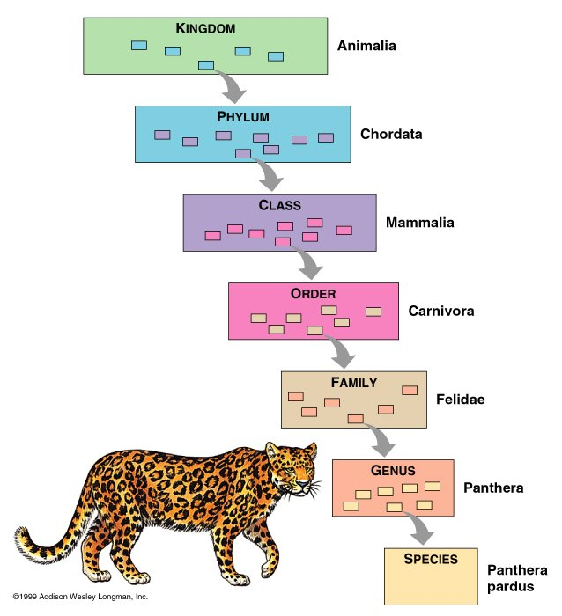
Classification
CLASSIFYING ORGANISMS

Slide 2
Classification Systems
Classification systems are how we organize organisms
This is called taxonomy
The classification of organisms has changed and evolved over the years due to new knowledge
Greater understanding of evolutionary relationships, thanks to DNA technology, has allowed for more detailed classification

Slide 3
Classification
The classification of organisms begins with the largest groupings and moves down to the smallest (domain→ species)
The classification order is as follows:
Domain
Kingdom
Phylum
Class
Order
Family
Genus
Species

Slide 4
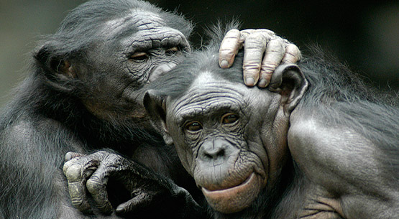
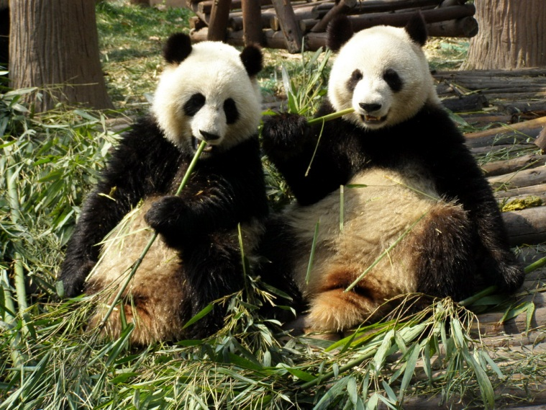
What is a Species?
Group of the same organisms
Live together
Mate and produce viable offspring
“Viable” means they can have babies of their own

Slide 5
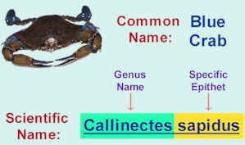
Scientific Name
The scientific name of an organism is the Genus and Species of an organism
Always written in italics
Example: Humans are Homo sapiens
This “two name” system is called binomial nomenclature

Slide 6
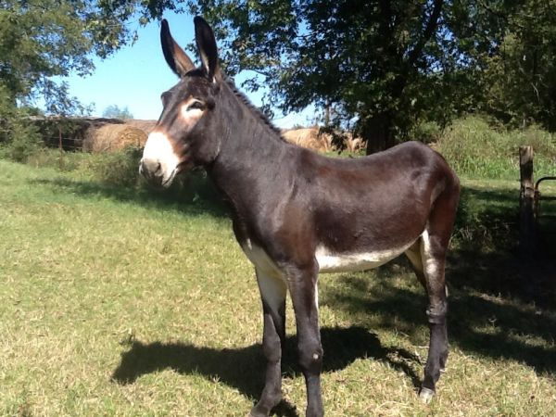
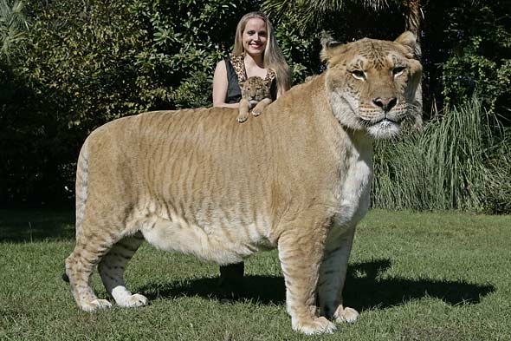
Case Study: Interbreeding
Only species are able to interbreed. Organisms of two different species normally will not breed
Sometimes, organisms within the same genus are able to interbreed, but the offspring are not viable (they cannot reproduce!)
Example: Mules; Ligers
These hybrid organisms are much more common in captivity than in the wild

Slide 7
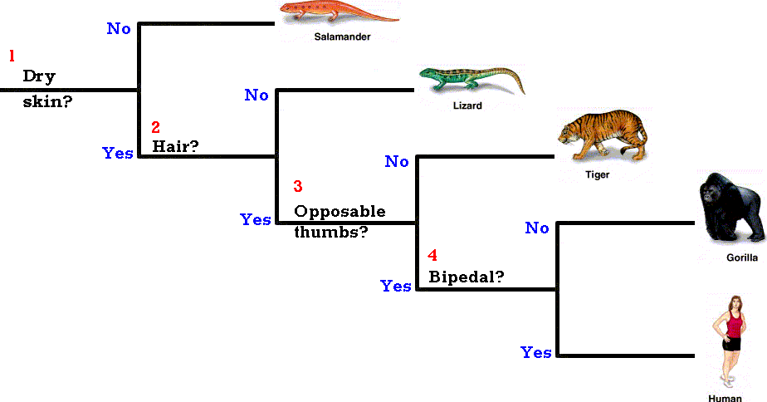
Dichotomous Keys
A key that helps identify an organism
Uses questions to lead you to the scientific name of an organism
By looking at features of an organism, the key will help you determine what it is!

Slide 8
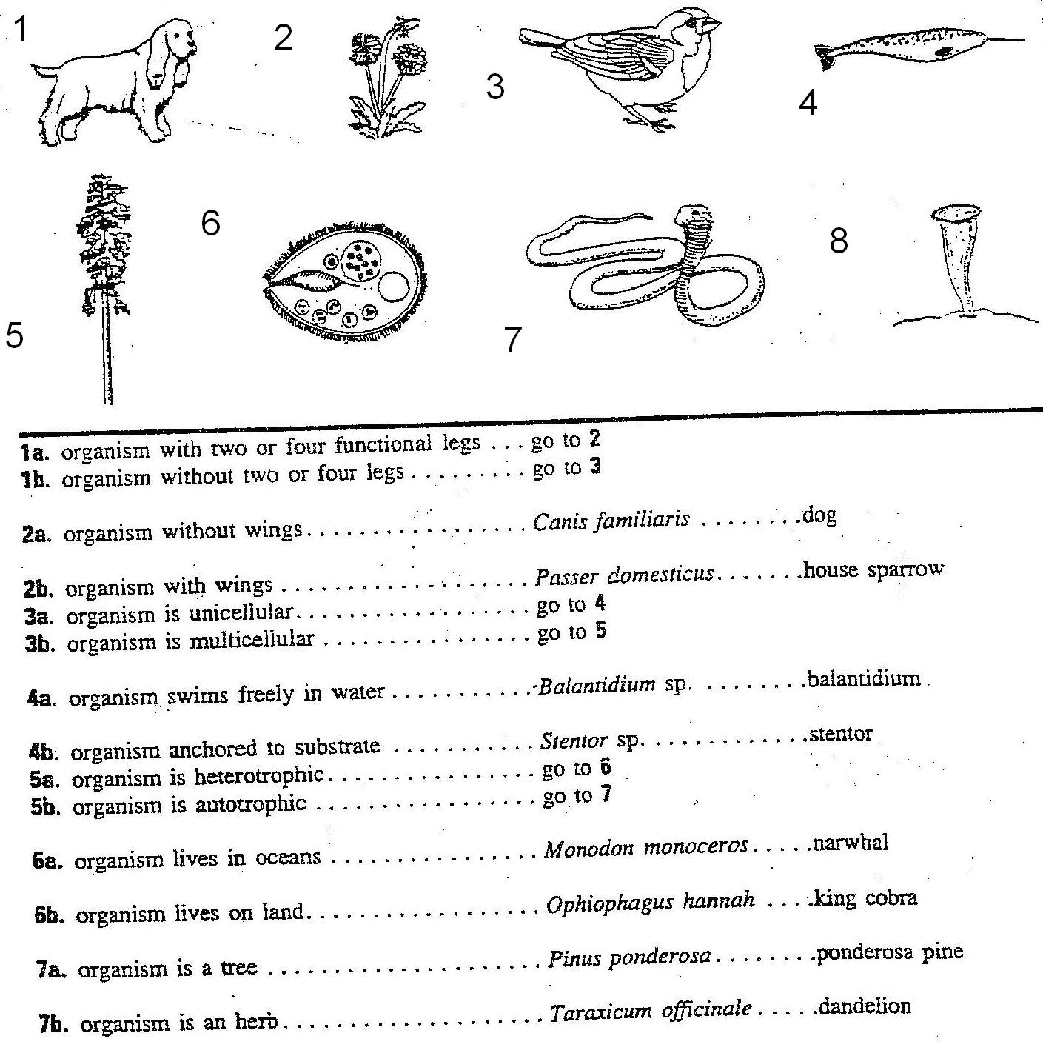
Follow Steps to find out what organism #3 is? #7?

Slide 9
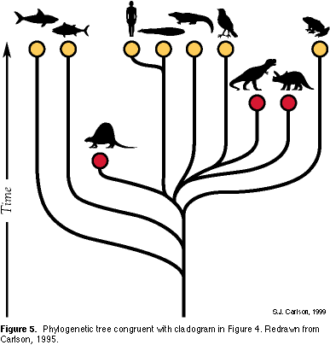
Phylogenetic Trees
Shows the evolutionary relationship between organisms
Can show which organisms are more closely related than other organisms

Slide 10
Phylogenetic Trees
Which organism is more closely related to man? __________ Which organism is man more closely related to: Frog or bird? Why?

Slide 11
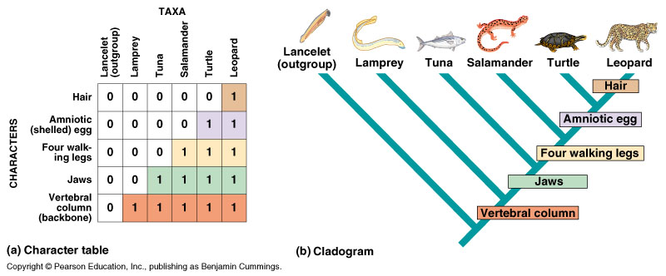
Cladogram
Shows relationships up-close; characteristics they share

